Slide 1


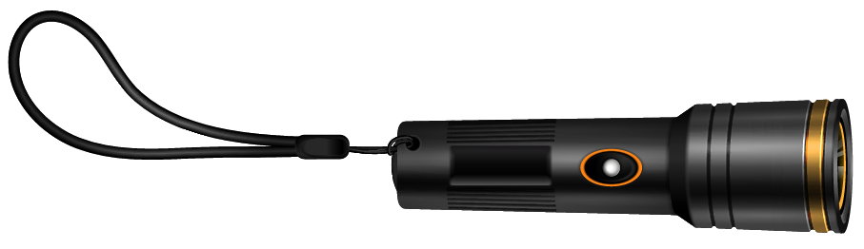
Toronto Crime Data Intelligence
Team York:
Prappan Batra
Dhairya Dangi
Param Panchal
Vrajkumar Patel
Pravina Prajapati

Slide 2


Agenda
Business Problem
Analytics Questions
Scope Statement
Data Sources / Key Data Entities and Flows
Brief overview of the data manipulation process and data output
New solution design and it’s fit into the existing IT architecture
New solution implementation and outcome testing
Potential solution optimization
Overall quality/professionalism

Slide 3


Business Problem
Due to a lack of thorough information about crime patterns and trends across various neighborhoods and types of establishments, law enforcement agencies in Toronto are having difficulty in the effective allocation of resources and putting crime prevention initiatives into practice.

Slide 4

Analytics Questions
01
What are the key crime trends and patterns in Toronto over the past few years?
What are the seasonal variations and day-of-week patterns in crime occurrences?
Which specific Premise in Toronto experiences the highest incidence of crime?
Which year experiences the lowest number of crimes and highest number of crimes?
What is the distribution of crimes depending on offense type?
02
03
04
05

Slide 5

Scope Statement
Data Collection and Integration: Collecting historical crime data from the public safety data portal of TPS.
Data Analysis: Analyzing historical crime trends, including seasonal variations and spatial distribution patterns across neighborhoods and Offense types.
Descriptive Analysis: Understand patterns and classification of crimes.
Reporting and Visualization: Creating dashboards to communicate insights effectively to stakeholders.
Community Engagement: Collaborating with community stakeholders and organizations to share crime statistics, insights, and prevention strategies.

Slide 6
Data Source / Key Data Entities
The data used in this project originated from the Toronto Police Service Public Safety Data Portal. The dataset specifically pertains to Major Crime Indicators (MCI) and is openly available to the public. This data was retrieved from the Toronto Police Service's data portal.
Key Data Entities:
Offence Information
Timestamp Information
Location Information

Slide 7
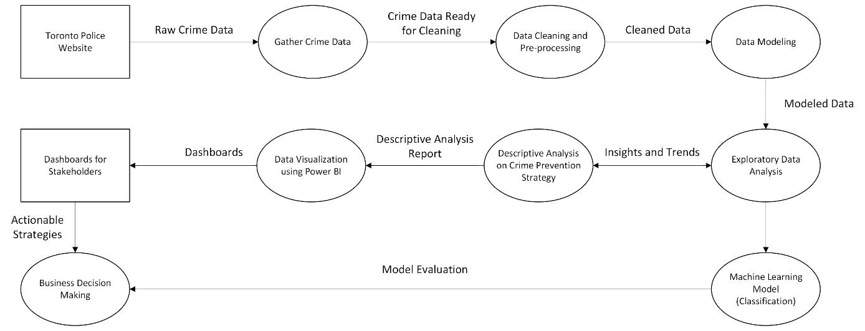
Data Flows

Slide 8

Data Manipulation Process
Prioritizing recency, data from 2019 to 2024 has been selected for analysis. Hence, data from 2014 to 2018 has been excluded.
Dropping Null Values
To maintain dataset integrity, missing values were identified and removed using the `isnull()` and `dropna()` methods. This ensured the dataset was complete and ready for accurate analysis, preventing biased results or statistical errors.
Dropping Unnecessary Records
In the data, records with "NSA" for neighborhoods or coordinates of (0,0) were removed, as they either fell outside the City of Toronto or were otherwise invalid. These exclusions, which affected about 2% of the total data, help ensure more accurate analysis by removing outliers.

Slide 9

Data Output
In order to prepare the data for additional analysis, extensive data modification procedures are used throughout the Toronto Major Crime Indicators Analysis Project's data output phase. The dataset will be refined and organised using a variety of algorithms and programming techniques after it has been cleaned and pre-processed in Jupyter Notebook. To obtain valuable insights, this may involve statistical analysis, feature engineering, and the use of machine learning techniques like classification. After the data has been analysed, Power BI will be used to produce comprehensive reports, interactive dashboards, and visualisations. Stakeholders will find these outputs crucial as they offer practical insights into Toronto's crime trends, patterns, and spatiotemporal dynamics.

Slide 10
Existing IT Architecture
This section provides an overview of the Toronto Police Service's IT architecture for managing and analyzing crime data, summarizing component functionalities, their fit within the IT ecosystem, and the connections integrating these components.
Records Management Services (RMS): Manages police reports, maintaining accuracy and quality.
Infrastructure Services: Provides technical support for all communication systems, including computer networks, data centers, and the 9-1-1 system.
Software Integration: Business Applications and Policing Applications are integrated using APIs, ensuring seamless data flow and interoperability.
Information Access: Processes public and legal requests for police service information.

Slide 11

Solutions Design

Slide 12
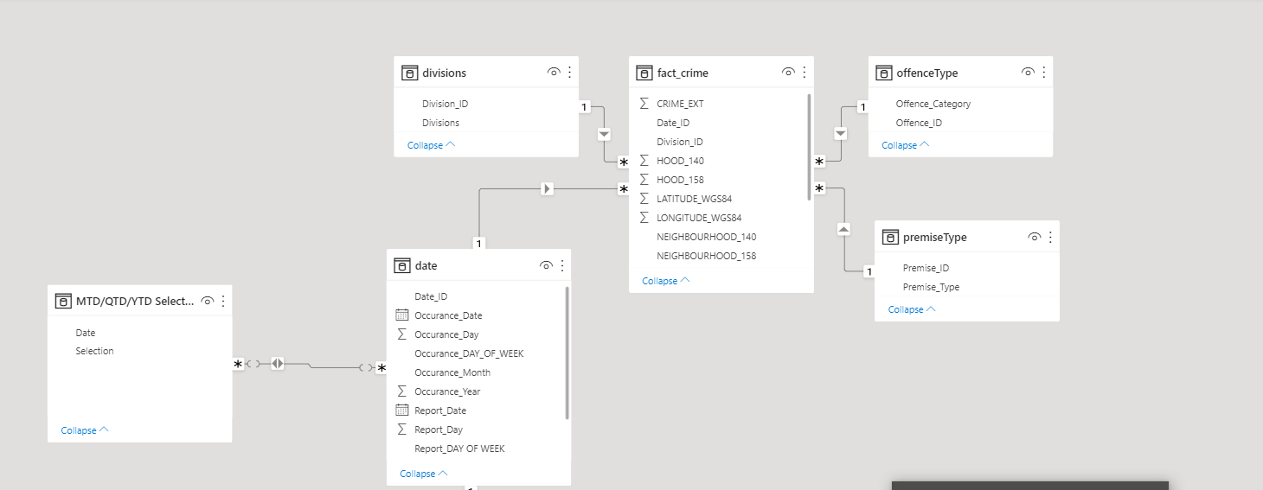
Snowflake Schema

Slide 13
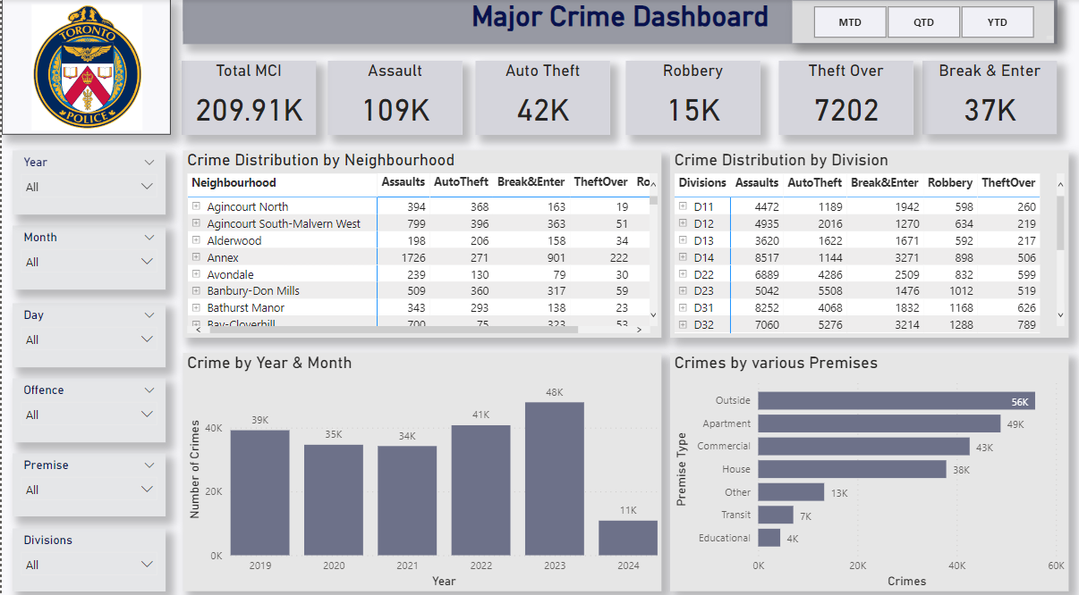
Dashboard

Slide 14
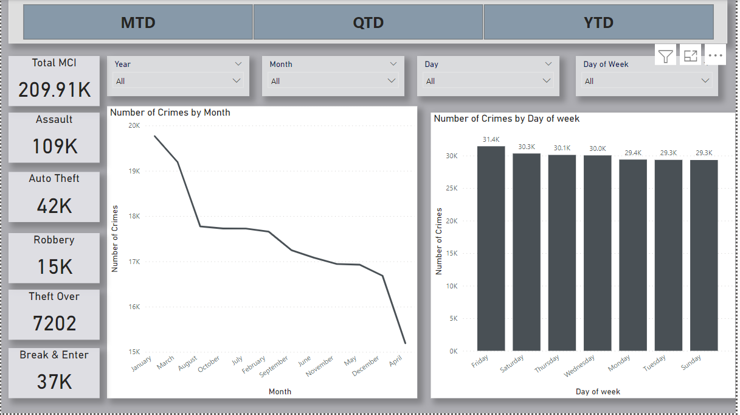
Dashboard

Slide 15
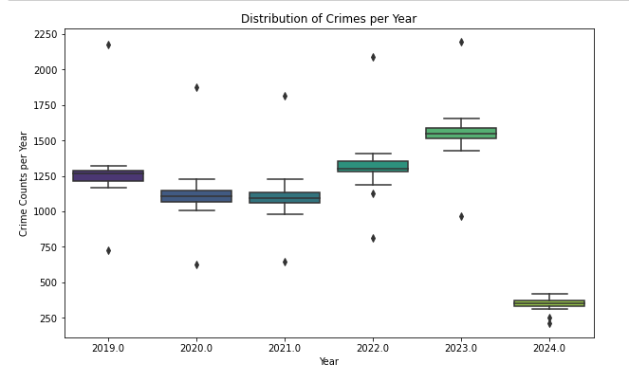
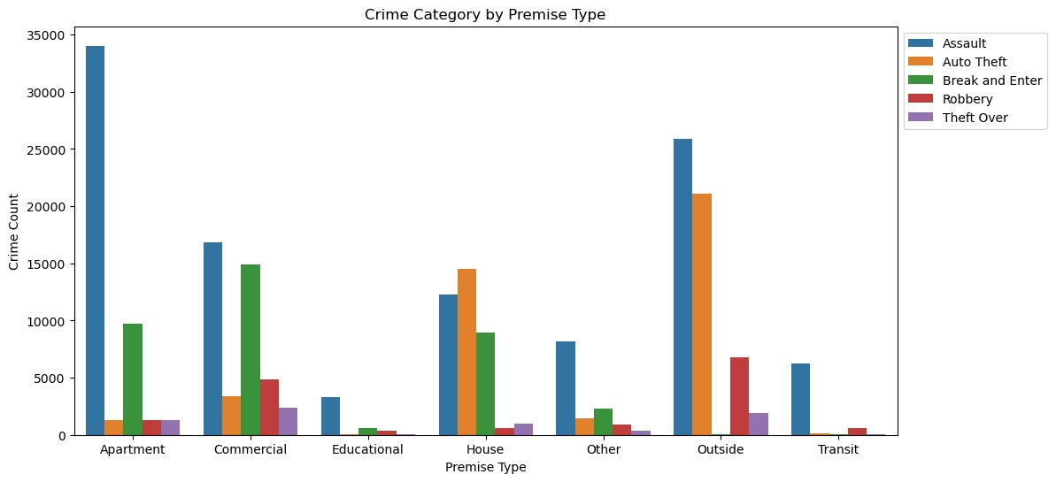
Exploratory Data Analysis

Slide 16
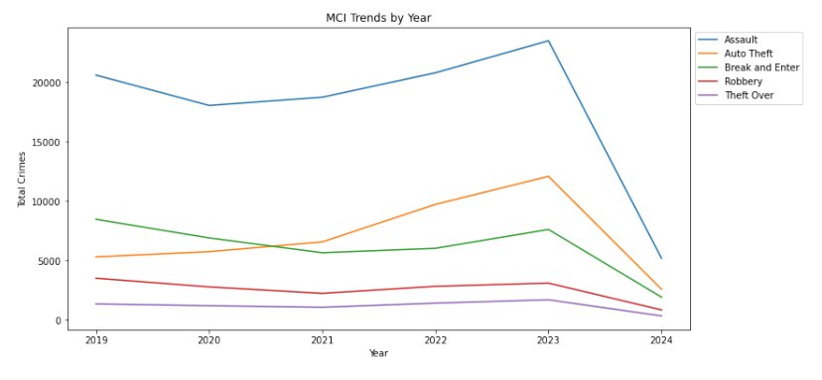
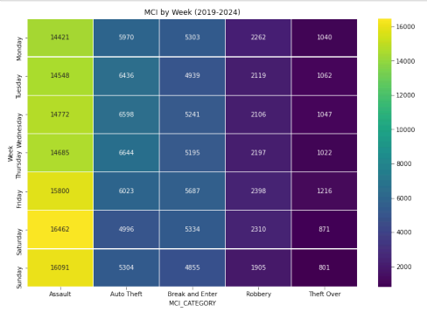
Exploratory Data Analysis

Slide 17
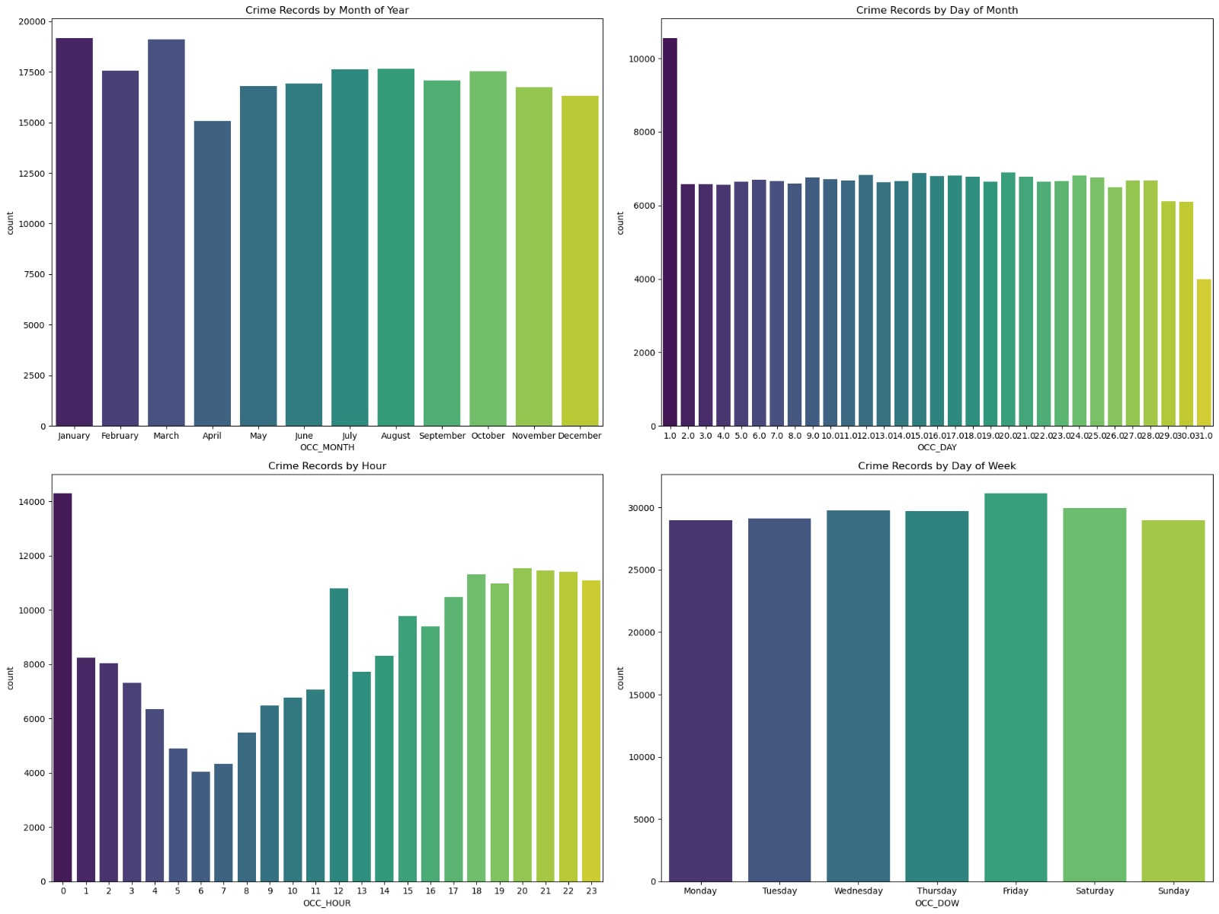
Exploratory Data Analysis

Slide 18
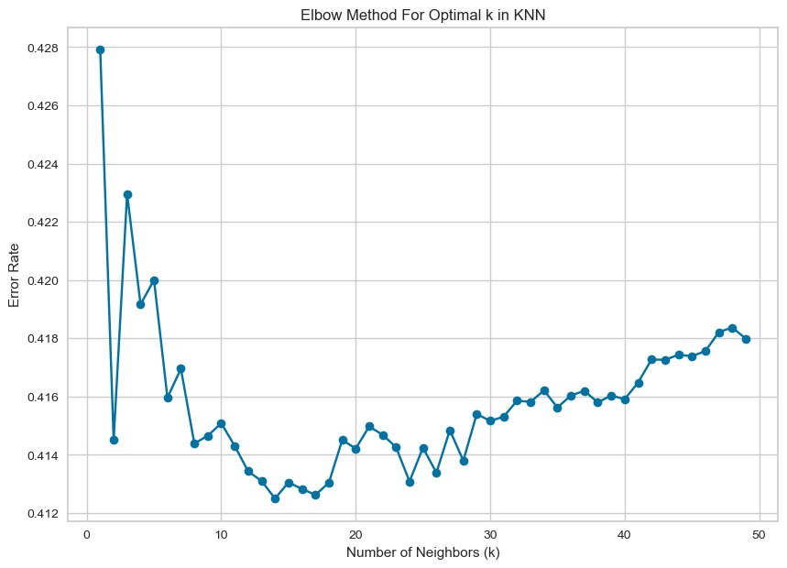
K – Nearest Neighbour Classifier

Slide 19
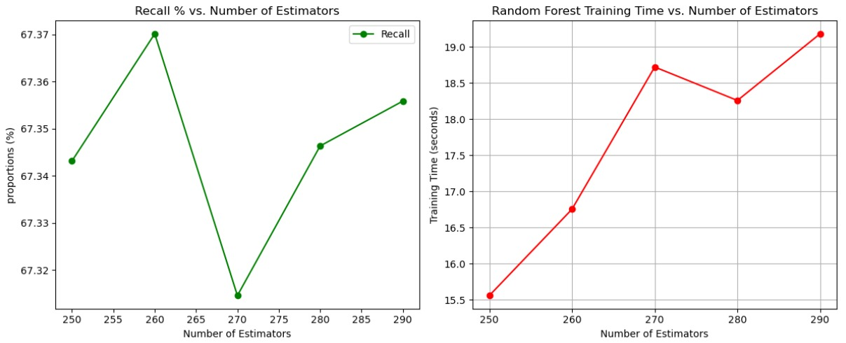
Random Forest Classifier

Slide 20
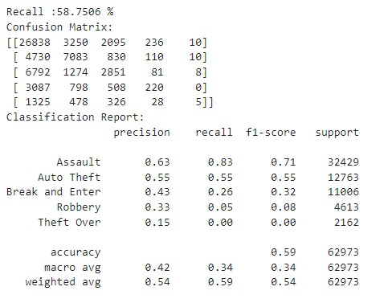
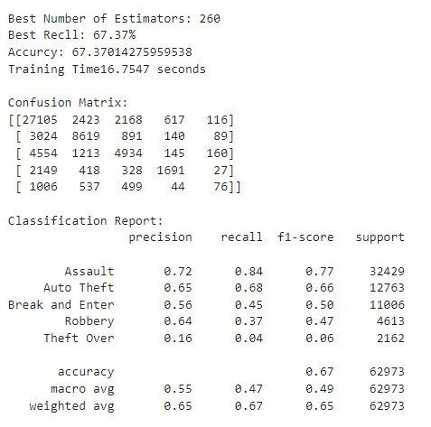
Outcome Testing
KNN
Random Forest

Slide 21
Optimization Techniques

Slide 22
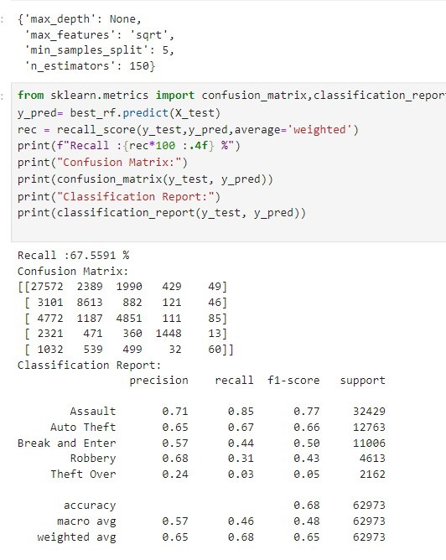
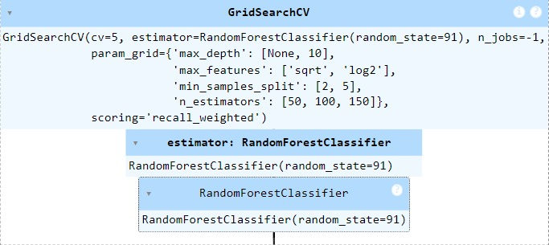
Random Forest
To enhance the performance of our Random Forest model, we employed GridSearchCV, a powerful tool for hyperparameter tuning in machine learning. GridSearchCV performs an exhaustive search over a specified parameter grid to find the combination of hyperparameters that yields the best performance for our model.

Slide 23
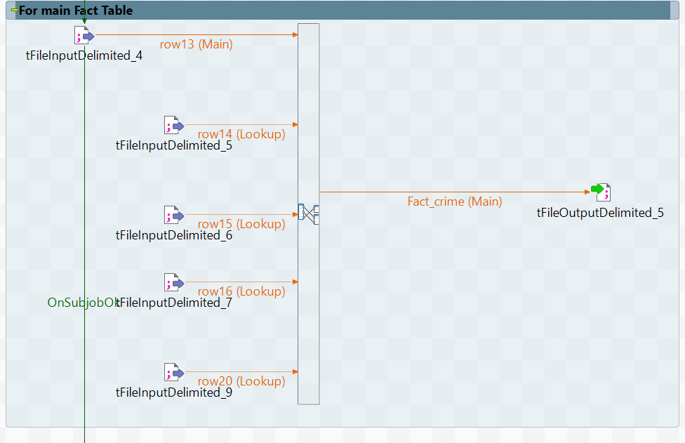
Visualization
Using Talend Open Studio for ETL Processes:
To address these challenges, we introduced Talend Open Studio, an ETL (Extract, Transform, Load) tool, into the data preparation process. This approach involved the following steps:
Data Extraction and Transformation
Creation of Dimension and Fact Table
files
Importing Data into Power BI

Slide 24
Potential Future Solutions

Slide 25
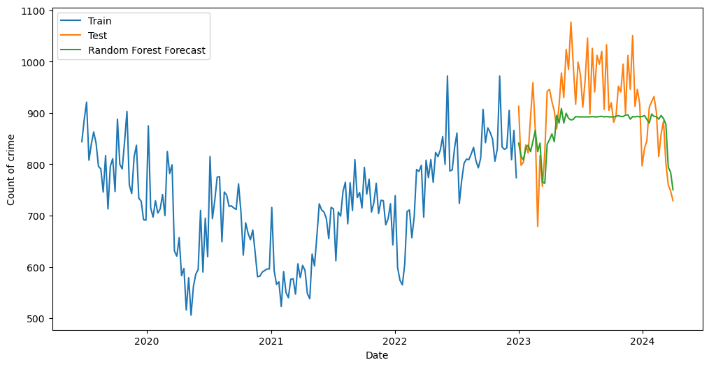
Random Forest Forecast

Slide 26
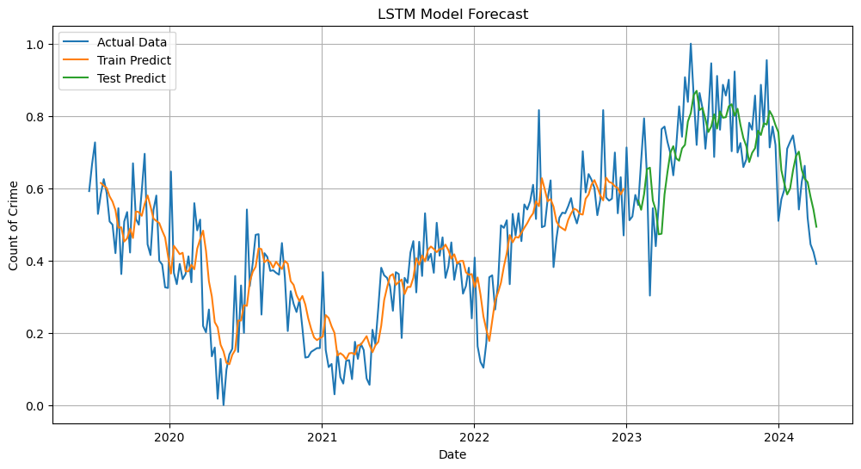
LSTM Forecast

Slide 27
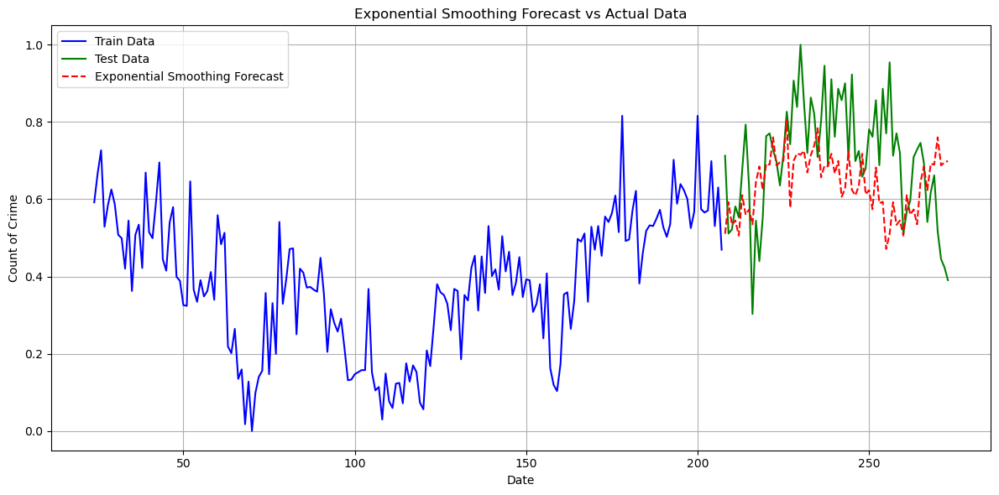
Exponential Smoothing Forecast

Slide 28





Overall Quality / Professionalism
Using Power BI:
Data Preparation and ETL Process
Model Optimization
Performance Optimization
Using ML:
Data Quality
Model Selection and Evaluation
Parameter Tuning
Comparison and re-evaluation

Slide 29


THANK YOU

